Slide 1
STOR 455 Class 26
Read: 9.1, 9.2
Exercises: 9.21, 33

Slide 2
Logistic Regression
In all of our regression models (so far) the response variable, Y, has been quantitative.
What if we want to model a categorical response?

Slide 3
Categorical Response Variables
Examples:
Whether or not a person smokes
Binary Response
Success of a medical treatment
Opinion poll responses
Ordinal Response

Slide 4
Categorical Response Variables
Examples:
Political preference
Nominal response
Three “flavors” of logistic regression:
binary
ordinal
nominal

Slide 5
Binary Logistic Regression
Response variable (Y) is categorical with just two categories (yes/no or success/failure or 0/1 …).
One approach: Code the response Y as a (0,1) dummy (indicator) variable.
Assume we have a single quantitative predictor X.

Slide 6
Titanic Survival
Y = Survived (0 = no; 1 = yes) X = Fare (ticket cost in dollars)
library(titanic)
data("titanic_train")
Titanic_mod = lm(Survived ~ Fare, data=titanic_train)
summary(Titanic_mod)
Coefficients:
Estimate Std. Error t value Pr(>|t|)
(Intercept) 0.3026994 0.0187849 16.114 < 2e-16 ***
Fare 0.0025195 0.0003174 7.939 6.12e-15 ***
---
Signif. codes: 0 ‘***’ 0.001 ‘**’ 0.01 ‘*’ 0.05 ‘.’ 0.1 ‘ ’ 1
Residual standard error: 0.4705 on 889 degrees of freedom
Multiple R-squared: 0.06621, Adjusted R-squared: 0.06516
F-statistic: 63.03 on 1 and 889 DF, p-value: 6.12e-15

Slide 7
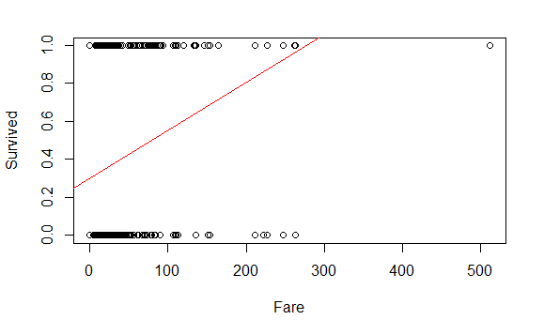
plot(Survived ~ Fare, data=titanic_train)
abline(Titanic_mod, col="red")

Slide 8
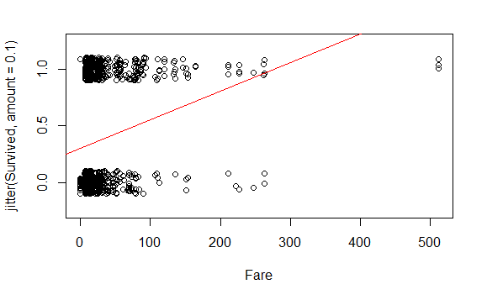
plot(
jitter(Survived, amount=0.1) ~ Fare,
ylim = c(-0.25,1.25),
data=titanic_train
)
abline(Titanic_mod, col="red")

Slide 9
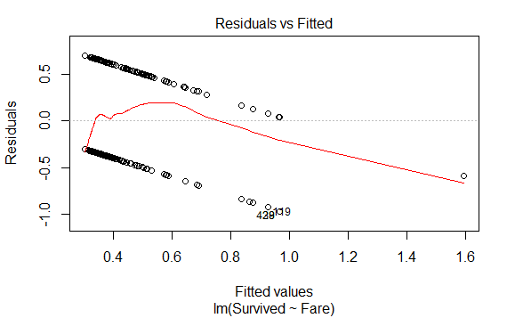
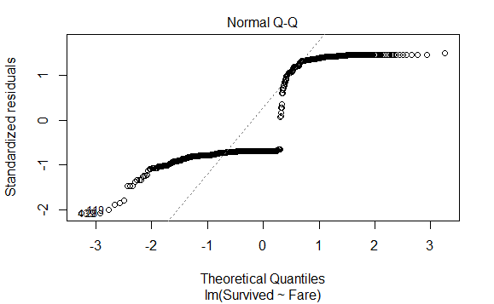
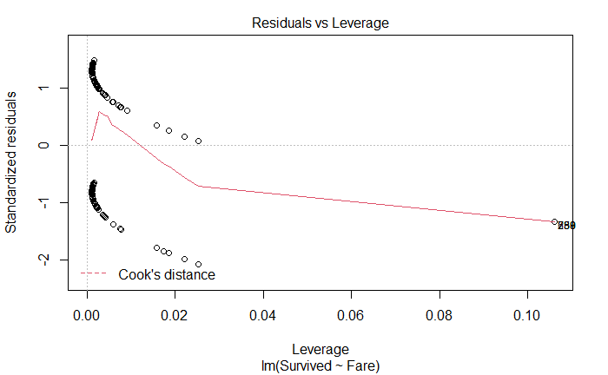
plot(Titanic_mod, c(1, 2, 5))

Slide 10
Binary Logistic Regression Model
Y = Binary response
X = Quantitative predictor
π = proportion of 1’s (yes, success,…) at any x
Probability form
curve(exp(B0+B1*x)/(1+exp(B0+B1*x)),add=TRUE, col="red")

Slide 11
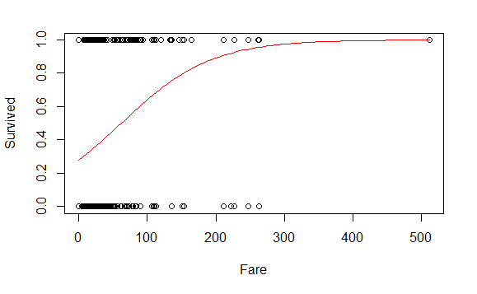
Titanic_logitmod = glm(Survived ~ Fare, family = binomial, data=titanic_train)
plot(Survived ~ Fare, data=titanic_train)
B0 = summary(Titanic_logitmod )$coef[1]
B1 = summary(Titanic_logitmod )$coef[2]
curve(exp(B0+B1*x)/(1+exp(B0+B1*x)),add=TRUE, col="red")

Slide 12
Predicting Proportion of “Success”
In regression the model predicts the mean Y for any combination of predictors.
What’s the “mean” of a 0/1 indicator variable?
Goal for this model: Predict the “true” proportion of success, π, at any value of the predictor.

Slide 13
set.seed(10012020)
passenger = titanic_train[sample(nrow(titanic_train),1),]
passenger$Fare
[1] 52.5542
predict(logitmodT, passenger, type="response")
622
0.4643927

Slide 14
logitmodT=glm(Survived~Fare,family=binomial,data=titanic_train)
plot(Survived~Fare, data=titanic_train)
B0 = summary(logitmodT)$coef[1]
B1 = summary(logitmodT)$coef[2]
curve(exp(B0+B1*x)/(1+exp(B0+B1*x)),add=TRUE, col="red")

Slide 15
Binary Logistic Regression Model
Y = Binary response
X = Quantitative predictor
π = proportion of 1’s (yes, success,…) at any x
Probability form
Logit form
Linear Model

Slide 16
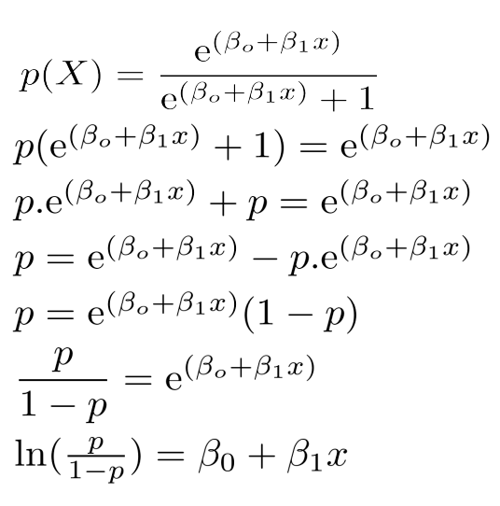
Binary Logistic Regression Model
Probability form
Logit form

Slide 17
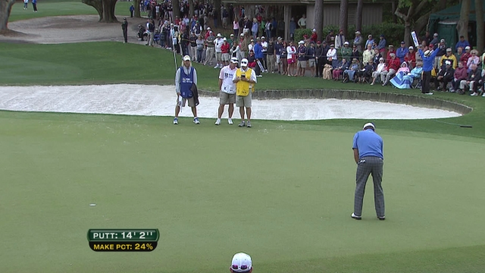
Golf Putts

Slide 18
Example: Golf Putts
Length | 3 | 4 | 5 | 6 | 7
Made | 84 | 88 | 61 | 61 | 44
Missed | 17 | 31 | 47 | 64 | 90
Total | 101 | 119 | 108 | 125 | 134
Build a model to predict the proportion of putts made (success) based on length (in feet).
Data are in Putts1 of Stat2Data.

Slide 19
Logistic Regression for Putting
modPutt=glm(Made~Length,family=binomial,data=Putts1)
summary(modPutt)
Coefficients:
Estimate Std. Error z value Pr(>|z|)
(Intercept) 3.25684 0.36893 8.828 <2e-16 ***
Length -0.56614 0.06747 -8.391 <2e-16 ***
---
Null deviance: 800.21 on 586 degrees of freedom
Residual deviance: 719.89 on 585 degrees of freedom
AIC: 723.89

Slide 20
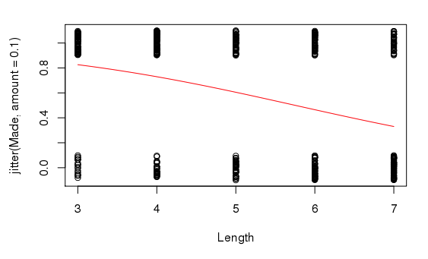
B0 = summary(modPutt)$coef[1]
B1 = summary(modPutt)$coef[2]
plot(jitter(Made, amount = 0.1) ~ Length, data = Putts1)
curve(exp(B0+B1*x)/(1+exp(B0+B1*x)), add=TRUE, col="red")

Slide 21
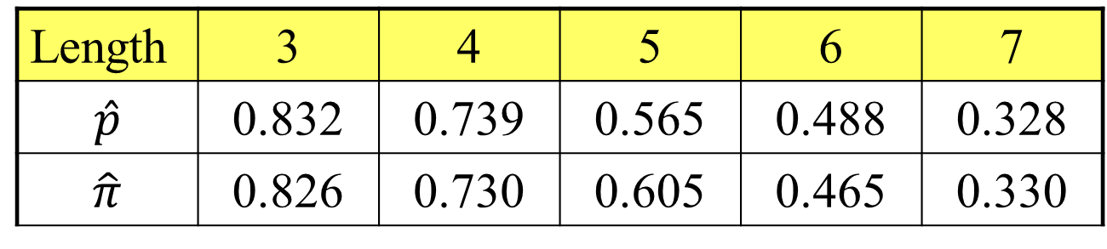
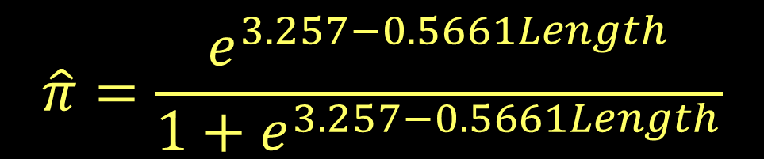
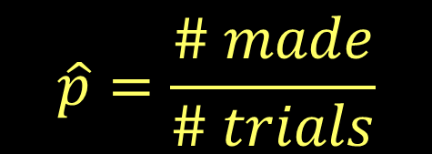
Golf Putts Probabilities
$$\hat{p}=\frac{\# made}{\# trials}$$
Length | 3 | 4 | 5 | 6 | 7
$$\hat{p}$$ | 0.832 | 0.739 | 0.565 | 0.488 | 0.328
$$\hat{π}$$ | 0.826 | 0.730 | 0.605 | 0.465 | 0.330
$$\hat{π}=\frac{e^{3.257−0.5661Length}}{1+e^{3.257−0.5661Length}}$$

Slide 22

Golf Putts Probabilities
Length | 3 | 4 | 5 | 6 | 7
$$\hat{p}$$ | 0.832 | 0.739 | 0.565 | 0.488 | 0.328
$$\hat{π}$$ | 0.826 | 0.730 | 0.605 | 0.465 | 0.330
Putts.table = table(Putts1$Made, Putts1$Length)
p.hat = as.vector(Putts.table[2,]/colSums(Putts.table))
p.hat
[1] 0.8316832 0.7394958 0.5648148 0.4880000 0.3283582

Slide 23

Golf Putts Probabilities
Length | 3 | 4 | 5 | 6 | 7
$$\hat{p}$$ | 0.832 | 0.739 | 0.565 | 0.488 | 0.328
$$\hat{π}$$ | 0.826 | 0.730 | 0.605 | 0.465 | 0.330
logit = function(B0, B1, x)
{
exp(B0+B1*x)/(1+exp(B0+B1*x))
}
pi.hat = 0
for(i in 3:7)
{
pi.hat[i-2] <- logit(B0, B1, i)
}
pi.hat
[1] 0.8261256 0.7295364 0.6049492 0.4650541 0.3304493

Slide 24
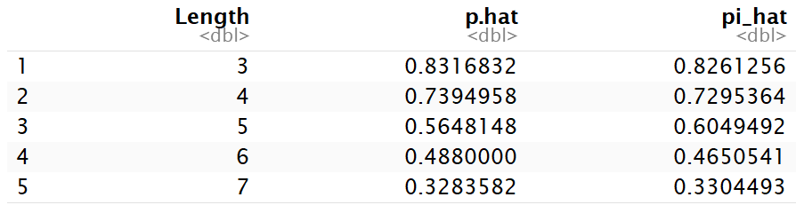
Golf Putts Probabilities
Length | 3 | 4 | 5 | 6 | 7
$$\hat{p}$$ | 0.832 | 0.739 | 0.565 | 0.488 | 0.328
$$\hat{π}$$ | 0.826 | 0.730 | 0.605 | 0.465 | 0.330
Putts = data.frame(
"Length" = c(3:7),
"p.hat" = p.hat,
"pi.hat" = pi.hat)

Slide 25
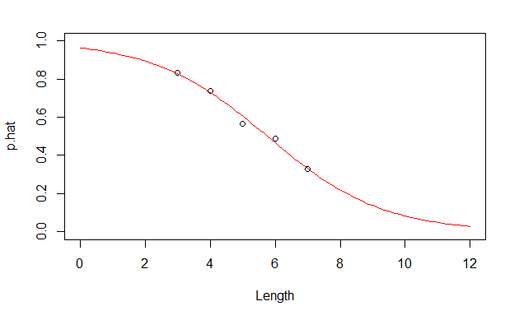
Probability Form of Putting Model
plot(p.hat~Length,ylim=c(0,1), xlim=c(0,12), data=Putts)
curve(logit(B0, B1, x), add=TRUE, col="red")

